Slide 1
USAR
Course Name- Communication Skills
Faculty Name- Ms. Priya Sharma
CONCORD (SUBJECT VERB AGREEMENT)
DISCOVER . LEARN . EMPOWER

Slide 2
Course Objectives
The Course aims to:
1 | Stress on students awareness of interpersonal communication skills and appropriate usage of verbal and non-verbal expression in social and professional environment.
2 | Prepare the student for discourse in English, using a number of communication strategies.
3 | Introduce them to key concepts of Morality, Diversity & Inclusion
4 | Provide foundations for the placement process of the student.

Slide 3
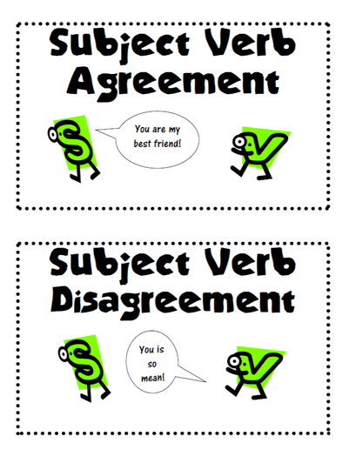
COURSE OUTCOMES
Space for visual (size 24)
On completion, the students are expected to
CO Number | Title | Level
CO1 | Display moral values, ethics and sensitivity for diversity and inclusion. | Apply
CO2 | Perform effectively in the placement process. | Apply
CO3 | Analyse and summarize information, ideas and opinions on a social issue using grammatically correct English. | Analyse
CO4 | Evaluate facts to write research and short official, technical or social reports. | Evaluate
CO5 | Create communication material for an organization dedicated to a social cause and use electronic/social media to share concepts and ideas. | Create
https://www.kilmerlibrary.org

Slide 4
Why Subject Verb Agreement?
Incorrect Subject Verb Agreement can cause your writing to be confusing to the reader.
Example: If your subject and verb disagree you does not sound so good.
She are a nice person. (Incorrect)

Slide 5
Rule 1
Subjects and verbs must agree in number.
Example: She writes every day.( SS- VS)
They write every day.( SP-VP)

Slide 6
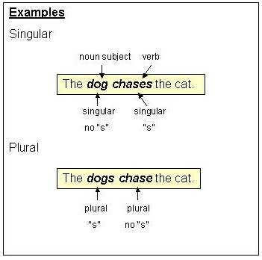
Subject Verb Agreement
Subjects and verbs must AGREE with one another in number (singular or plural).
Thus, if a subject is singular, its verb must also be singular; if a subject is plural, its verb must also be plural.
https://webapps.towson.edu/ows/moduleSVAGR.htm

Slide 7
Rule 2
Don’t get confused by the words and phrases that come between the subject and verb; they do not affect agreement.
Example: This movie, out of all other movies, is my favourite.

Slide 8
Rule 3
Two singular subjects connected by or or nor require a singular verb.
Example: A taxi or a bus is on its way.
A blue or White shirt is fine for an interview.

Slide 9
Rule 4
When sentences start with “there” or “here”, the subject will always be placed after the verb, identify it correctly.
Example: There are no cookies in the jar.
Here is the pen you were looking for.( INCORRECT)
There is a book in my bag.

Slide 10
Rule 5
Two singular subjects connected by either/or or neither/nor require a singular verb.
Example: Either Susan or Carol has a lecture today.
Neither Chemistry or Physics is easy to master.

Slide 11
Rule 6
If two subjects are joined by and they require a plural verb form.
Example: HE and I were present in the conference.

Slide 12
Rule 7
The verb is singular if the two subjects separated by and refer to the same person or thing.
Example: Slow and steady wins the race.
The poet and novelist is being honored.

Slide 13
Rule 8
If one of the words each, every or no comes before the subject, the verb is singular.
Example: No smoking or drinking is allowed.
Every man and woman is required to check in.

Slide 14
Rule 9
When two subjects are joined by as well as, with, along with, together with, the verb agrees with the first subject/noun, that is, if the first noun is singular then verb will be singular even if second noun is plural.
Example: Rita, along with her friends, has won the prize.

Slide 15
Rule 10
The singular verb form is usually used for units of measurement.
Example: Four quarts of oil was required to get the car running.

Slide 16
Rule 11
When I is one of the two subjects connected by either/or or neither/nor, put it second and follow with the singular verb am.
Example: Neither she nor I am going to the festival.

Slide 17
Rule 12
Sometimes nouns seem they are plural when they are really singular and vice-versa. Words such as glasses, pants, and scissors are regarded as plural (and require plural verbs) unless they are preceded by the phrase pair of (in which case the word pair becomes the subject).
Example: My glasses were on the bed.
My pants were torn.
A pair of my jeans is in the closet.

Slide 18
Rule 13
If one subject is singular and one plural and the words are connected by the words or, nor, neither/nor, either/or, and not only/but also, you use the verb form of the subject that is nearest the verb.
Example:
Either the bears or the lion has escaped from the zoo.
Neither the lion nor the bears have escaped from the zoo.

Slide 19
Rule 14
Use a singular verb with sums of money or periods of time.
Example: Ten dollars is a high price to pay.
Five years is the maximum sentence for that offense.

Slide 20
Rule 15
Collective nouns like herd, senate, class, crowd, etc. usually take a singular verb form.
Example: The herd is stampeding.
The Senate has taken a unanimous decision.

Slide 21
Rule 16
The indefinite pronouns anyone, everyone, someone, no one, nobody, are always singular and, therefore, require singular verbs. Everyone and everybody certainly feel like more than one person and, therefore, students are sometimes tempted to use a plural verb with them. Each is often followed by a prepositional phrase ending in a plural word (Each of the cars), thus confusing the verb choice. Each, too, is always singular and requires a singular verb.
Example: Everyone has done his or her homework.
Somebody has left her purse.

Slide 22
Rule 17
Some words end in -s and appear to be plural but are really singular and require singular verbs.
Example: The news from the front is bad.
Measles is a dangerous disease for pregnant women.

Slide 23
Exercise
A bouquet of yellow roses lend/lends color and fragrance to the room.
Annie and her brothers (is, are) at school.
George and Tamara (doesn't, don't) want to see that movie.
One of my sisters (is, are) going on a trip to France.
The movie, including all the previews, (take, takes) about two hours to watch.
Either answer (is, are) acceptable.

Slide 24
Answers
Lends
Are
Don’t
Is
Takes
Is

Slide 25
References
https://academicguides.waldenu.edu/writingcenter/grammar/subjectverbagreement
http://guidetogrammar.org/grammar/sv_agr.htm
https://examples.yourdictionary.com/examples-of-subject-verb-agreement.html
https://grammar.yourdictionary.com/sentences/20-rules-of-subject-verb-agreement.html
https://www.grammarbook.com/grammar/subjectVerbAgree.asp

Slide 26
Application
Using the correct grammar (when one writes or speaks) is important to avoid misunderstandings, and to help the other person understand easily. If ones English is too full of mistakes, it will slow down communication and conversations. It will be harder to express ones ideas and thoughts clearly and concisely.
Understanding Subject verb Agreement will help students to know the syntactical relation that exists between a subject and a verb in a sentence and to avoid ambiguities.

Slide 27
THANK YOU

